Slide 1
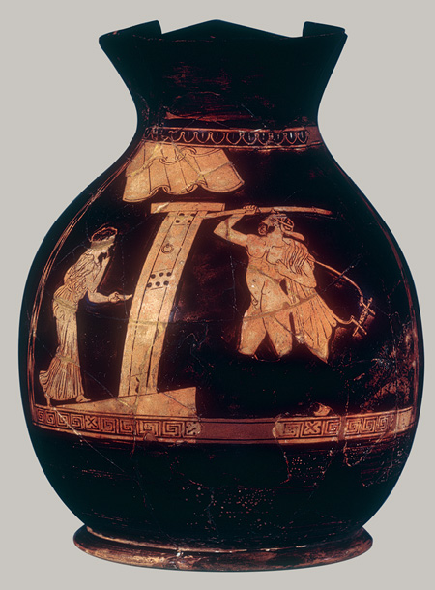
Ancient Greek Houses

Slide 2
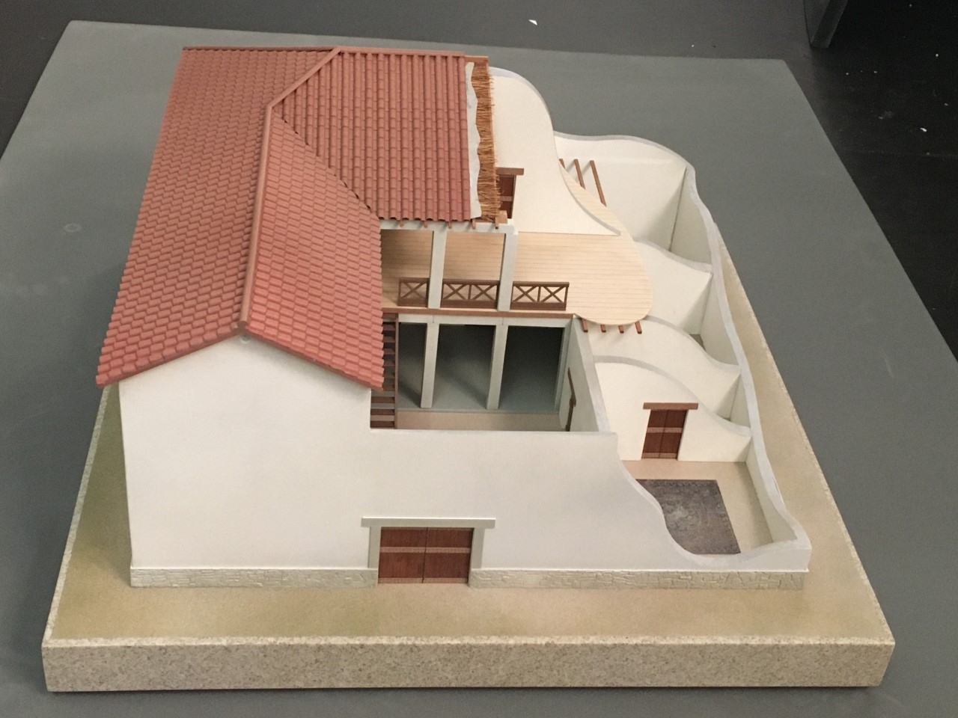
Greek houses might have looked like this

Slide 3
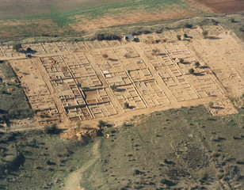
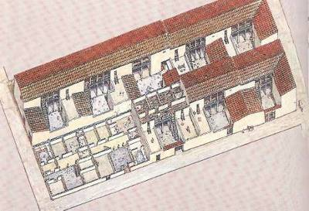
Olynthos

Slide 4
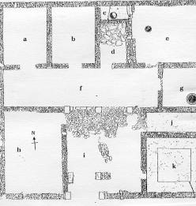
Two-storey houses?
Olynthos, House
Stairs in courtyard

Slide 5
Gynaikon – women’s quarters

Slide 6
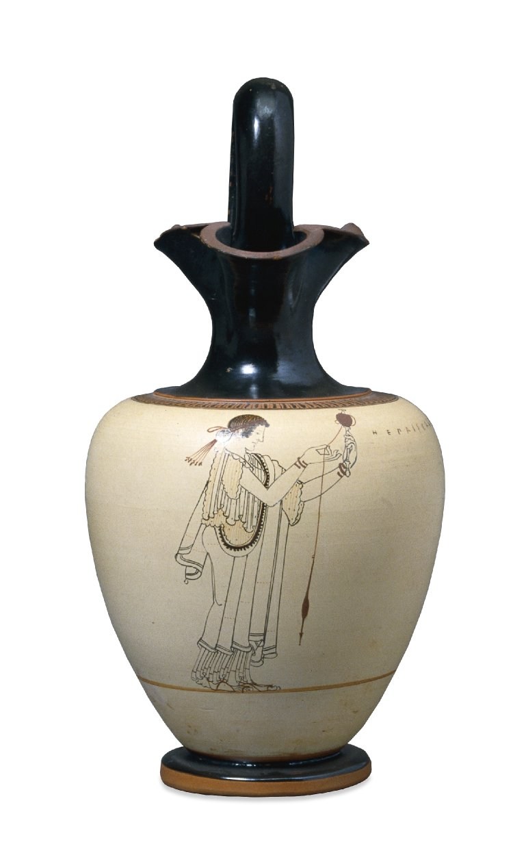
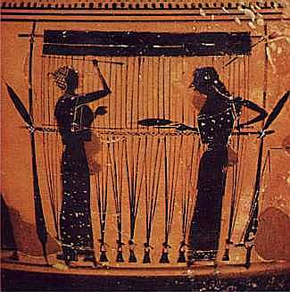
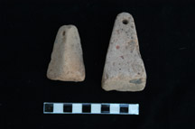
Making clothes: spinning and weaving

Slide 7
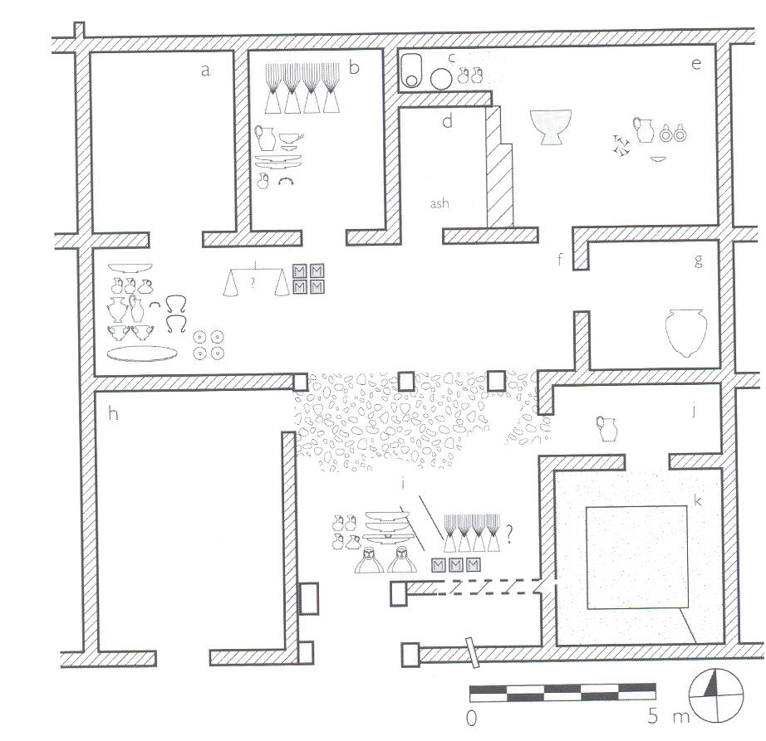
House at Olynthos
Loom weights in a room and in the courtyard
Andron

Slide 8
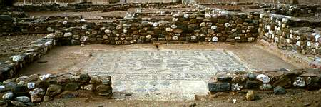
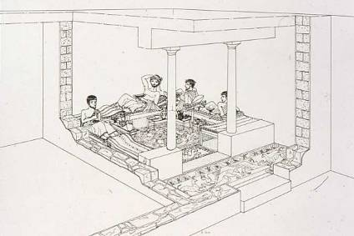
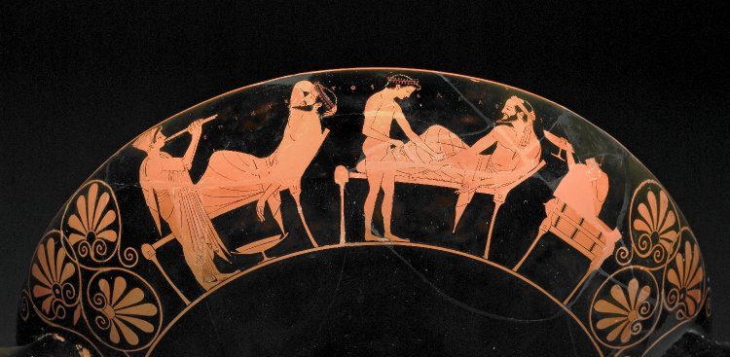
Andron – men’s dining room
Olynthos, andron

Slide 9
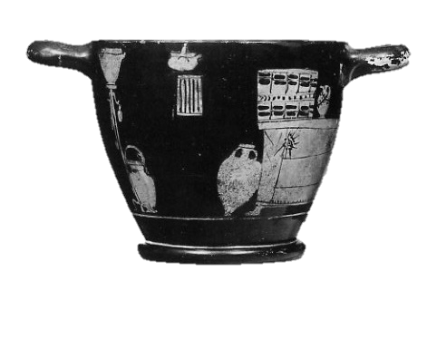
Storeroom
Olynthos, pithoi

Slide 10
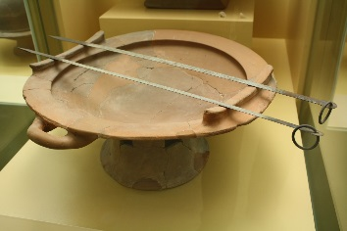
Cooking – portable brazier

Slide 11
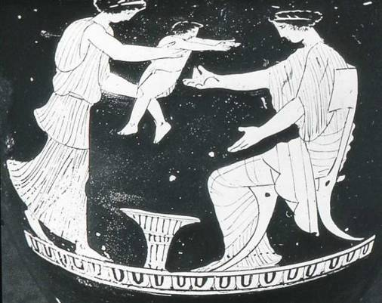
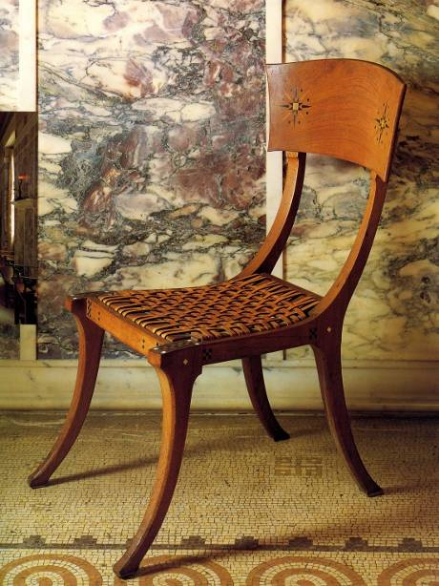
Furniture

Slide 12
Furniture

Slide 13
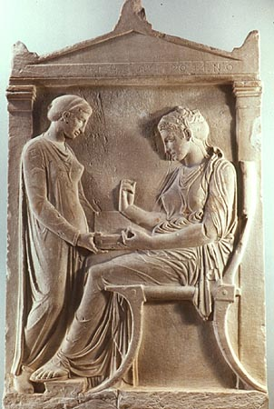
Chests
Boxes and Baskets

Slide 14
http://ancientgreece.co.uk
Daily Life
Challenge

